Slide 1
Isolated Words Recognition in Speech Signal Processing
Submitted By:
Rahul Khanna
13BEC0700
Project Guide:
Prof. Kalaivani S.
Associate Professor
Department of Communication Engineering
VIT University

Slide 2
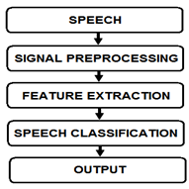
CURRENT STATUS
Speech signal processing includes the acquisition, manipulation, storage, transfer and output of speech signals. Various methodologies and technologies are developed to recognize the speech signal.
The major influencing steps in speech recognition are the feature extractions and decision making steps.
Some of commonly used feature extraction techniques are Relative Spectra Filtering of Log Domain Coefficients PLP (RASTA-PLP), Linear Predictive Cepstral Coefficients (LPCC), Mel-Frequency Cepstral Coefficients (MFCC) , etc.
Some commonly used decision making and mapping algorithms are Hidden Markov Model (HMM), Gaussian Mixture Model (GMM), Dynamic Time Warping (DTW), Decision Tress, Artificial Neural Networks, Deep Neural Networks, etc.

Slide 3
MOTIVATION.
The presence of unwanted noise in the recorded speech signal leads to reduction of efficiency of feature extraction and decision making steps.
Pre-Processing: It increases the amplitude of high frequency bands, but with this it also increase the amplitude of noise. As most of the noise is present at high frequencies only.
FFT: It is applicable to stationary and linear data. But, speech signal is non stationary and non-linear. Although, windowing is done but the windowed signal still remain non-stationary

Slide 4
Objective
The reduction of the unwanted noise in the system by Adaptive Time Frequency Filtering in an Isolated Word Recognition System and replacing FFT by using Hilbert Huang Transform, inMATLAB

Slide 5
Block Diagram
INPUT SIGNAL
WINDOWING
SNR ESTIMATION
TIME FREQUENCY MASKING
General overview of proposed Isolated Word Recognition System
MEAN SMOOTHING FILTERING
HHT
MFCC
VECTOR QUANTISATION
TRAINING
Training includes, till this part only
DECISION MAKING
RECOGNISED NUMBER

Slide 6
Methodology
The training of the system is implemented on the speech data recorded by the three speakers, each of them three times pronounces the 0-9 English numbers. The numbers are recorded at 16kHz .
In isolated word recognition system each number signal is framed by 25ms overlapped hamming window with the overlapping of 25 percentage. The ESNR is calculated for entire signal. This ESNR will be utilized in calculating the threshold value of adaptive time frequency mask. Then, adaptive time frequency masking is applied on each frame. Then HHT of frame is calculated. Then, the MFCC and dynamic features are calculated. Extracted features are clustered by LBG algorithm.
The testing of the system is implemented on the speech data recorded by the same users that had contributed for training purpose. Also, one more unknown user’s speech data is recorded to find the stability of designed system to unknown user. Each speaker, three times pronounces the 0-9 English numbers. The numbers are recorded at 16kHz .
CHANGES: THE FFT AND PRE-PROCESSING PART ARE CHANGED BY HHT AND ADAPTIVE TIME FREQUENCY MASKING

Slide 7
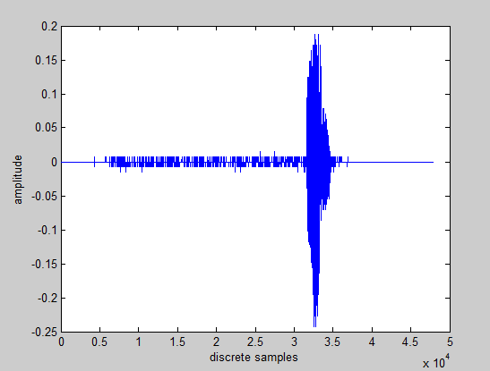
Input Signal
Training and testing of the system is done by the speech signal recorded by the four speakers. The sampling rate of 16kHz is taken and each recorded signals duration is 3 sec, thus total 48000 discrete values are processed in this system.
1.Training: Three speakers, each speaker three times recorded English numbers 0-9 (total 90 samples).
2.Testing: Four speakers. Three of the speakers are same as that contributed in training set. One speaker is unknown to the system . Each speaker one time recorded English numbers 0-9 (total 40 samples).
Input : number ‘1’

Slide 8
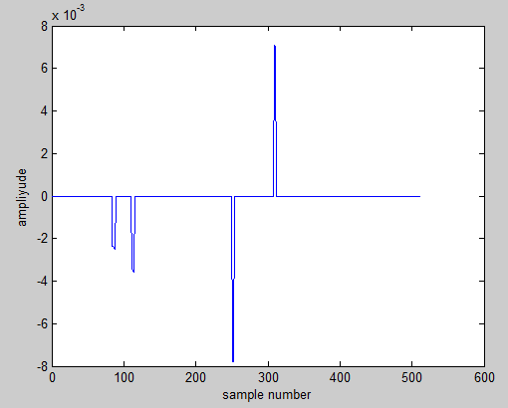
Windowing
Input signal is windowed using 25ms (i.e. 512 discrete values) of hamming window, with 10ms of window step. This is done to preserve the frequency response of every discrete value of the input signal. Frames whose sum is greater than 0.015.
72th Frame with sum greater than 0.015

Slide 9
Adaptive Time Frequency Masking
The adaptive mask is estimated for every frame. This method utilizes the concept of constant noise energy, to build an adaptive mask for every frame. This technique includes three steps:
SNR estimation
Time Frequency Masking
Mean Smoothing Filtering

Slide 10
Adaptive Time Frequency Masking: SNR estimation
This step calculates the SNR of speech signal. SNR is the measure to calculate the amount of noise present in speech signal. But, the non-uniformity of speech signal creates problem to calculate SNR. So, SNR of speech signal is calculated by dividing the total speech and noise signals in speech. Also, present of short time energy in silent frame is called as noise and that noise signals have low STE than speech signals. So, calculating the noise from low STE frames and speech from higher STE frames, SNR is estimated.
ESNR of speech signal

Slide 11
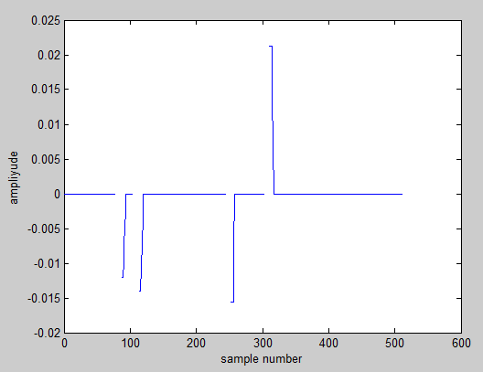
Adaptive Time Frequency Masking: Time Frequency Masking
In this step the mask is created and is applied on the frame. ESNR calculated is used to get the threshold value for the mask. This mask is applied on the frame.
Time frequency masked output of 72th frame of input signal

Slide 12
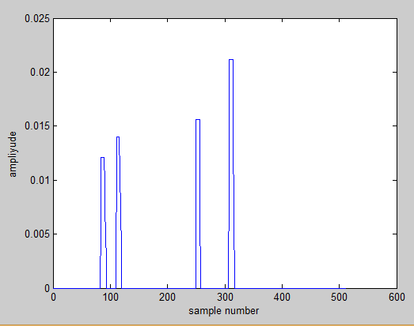
Adaptive Time Frequency Masking: Mean Smoothing Filtering
Since the noise power of AWGN keeps on changing from frame to frame. So to remove this instant variation, mean smoothing filter is to adaptive time frequency masked map. Average of 3 frequency frame are calculated
Mean smoothed masked output of 72th frame of input signal

Slide 13
Hilbert Huang Transform
This method is used to replace FFT. HHT resolves problem by using technique called Empirical Mode Decomposition, which is use to find all the intrinsic mode functions in that signal.
Spectrum is achieved by calculating FFT, followed by Hilbert transform, of all IMFs and then combining them. Steps included are:
Empirical Mode Decomposition process
Amplitude and frequency extraction

Slide 14
Hilbert Huang Transform: Empirical Mode Decomposition
This step is to find all the intrinsic mode functions of the signal. The extracted IMFs should have two properties , i.e.
1)Difference of number of zero crossing and peaks should be atmost one
2) Mean value envelope of local maxima and local minima should be zero

Slide 15
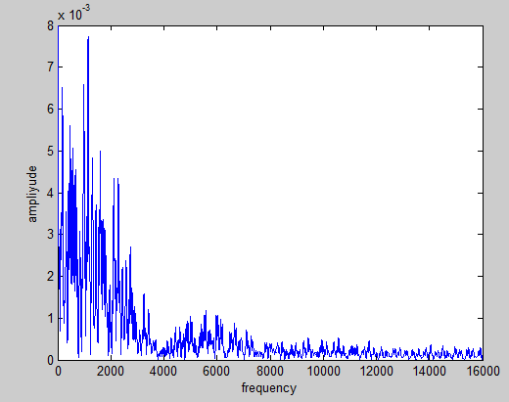
Hilbert Huang Transform: Amplitude and frequency extraction
It is a step to find frequency domain data of the signal . The Hilbert transform of the signal is computed to form an analytical signal. In this analytical signal, is the real part and Hilbert transform computed is the imaginary part. Since the signal is non stationary, the discrete cosine transform of the analytical signal is calculated. The resultant signal is the required amplitude spectrum of the input speech signal.
Frequency domain representation of 72th frame input signal

Slide 16

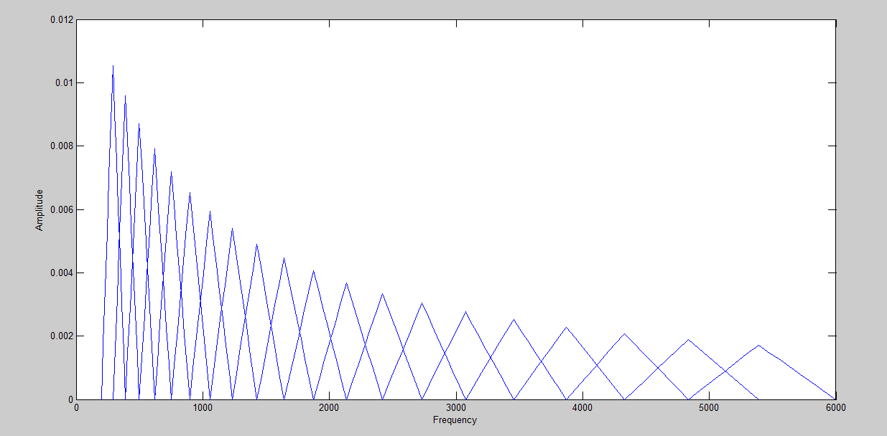
MFCC
The acoustic model used in this paper uses the MFCC model and 12 MFCC features are extracted from speech signal. MFCC uses the 20 overlapped warped triangular shaped filters. In mel scale these filters are equally spaced. Since the relation between mel and frequency scale is non- linear, these filters are termed as warped filters.
Relationship between mel and frequency domain
Mel filter bank

Slide 17
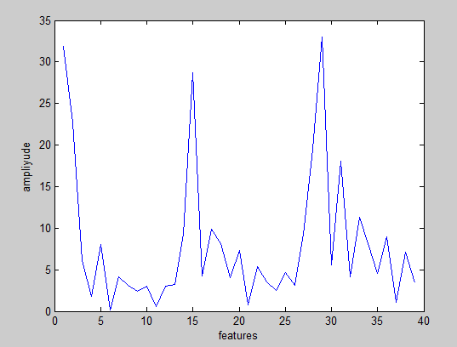
MFCC process
The frequency domain data is passed through the warped triangular filters. The output of every filter is summed and from those, first 12 coefficients are only considered. To compute the dynamic features, the delta and delta delta of those 12 coefficients is calculated. Also, their respective energies are also calculated. Thus, total 39 features are calculated from every frame
MFCC of 72th frame of input signal

Slide 18
Vector Quantization
From here onwards all the calculations are computed without graphical reference. From, here the system is divided into two sub-systems, one with LBG Algorithm and other without it.
After extracting the MFCC features, for one sub-system LBG Algorithm is implemented on the extracted features, to map the data to form codebook. It is similar to k-mean algorithm.

Slide 19

Training
During training of the system, the data collected is stored in the database with the English number it belongs to. This data is stored in the form of cell in the MATLAB. And, during testing phase the data is taken from the database to compute the decision making part.
Database created

Slide 20
Decision Making
This part is only computed during testing of the system. The decision making is based on statistical results given by Sum of Squared Error (SSE) method. The training set’s digit with minimum SSE is the recognized output.

Slide 21

Software Details
Main Program and related functions of speech recognition system will be written and simulated using MATLAB 2012b

Slide 22
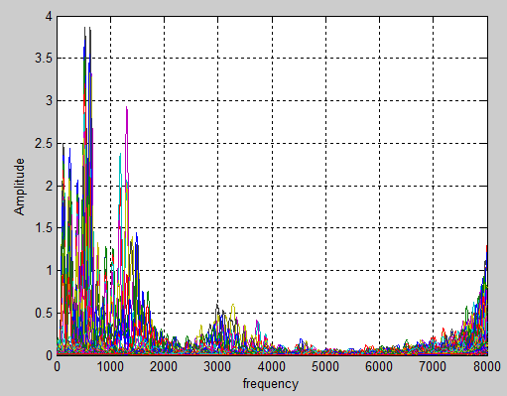
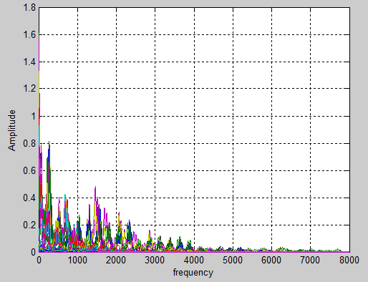
Result: 1) Improvement in estimated signal to noise ratio
Improvement in ESNR
Digit spoken (0-9) | ESNR |  | Percentage Improvement by masking
 | Before masking | After masking
0 | 76.09 | 110.26 | 44.91
1 | 53.61 | 84.13 | 56.92
2 | 84.53 | 121.9 | 44.21
3 | 51.67 | 83.57 | 61.73
4 | 85.9 | 109.8 | 27.8
5 | 82.45 | 105.72 | 28.22
6 | 79.01 | 102.12 | 29.25
7 | 84.71 | 115.87 | 36.78
8 | 78.08 | 100.56 | 28.8
9 | 74.25 | 107.62 | 44.94
Spectrum of input signal, obtained by general system (left) and Spectrum of input signal, obtained by proposed system (right)

Slide 23
Result: 2) Unknown speaker’s word recognition rate 3) Improvement in known speaker’s word recognition rate
Improvement by systems with HHT+masking and FFT+masking
The word recognition rate of unknown speaker’s data set is zero. This means that given system cannot be used by the unknown speakers.
The word recognition rate varies from sub-system to sub-system
Sub-System | FFT + MASKING | HHT + MASKING
WITHOUT LBG | 13.33% | 23.33%
WITH LBG | 3% | 3%

Slide 24
Conclusion
The experimental results shows that the proposed method cannot be used by unknown speakers. Also, it shows the improvement in the ESNR by at least 25% and thus the improvement in isolated word recognition by 3% and 23.33% in sub-systems in which one utilizes vector quantization technique and other do not respectively.

Slide 25
References
L. R. Rabiner and Biing-Hwang Juang, “Fundamentals of speech recognition”, Printice HallSignal Processing Series, Alan V. Oppenheim, Series, Editor, 1993
Huang, N. E., and Z. Wu, “A review on hilbert-huang transform: Method and its applications to geophysical studies”, Rev. Geophysics., 46, RG2006, 2008
Vani H.Y., “Hilbert-huang transform based speech recognition”, Second International Conference on CCIP, 2016
A. M. Gouda, M. Tamazin and M. Khedr, “Robust Automatic speech recognition system based on using adaptive time frequency masking”, IEEE, pp.181-186, 2016
Roma Bharti and Priyanka Bansal, “Real time speaker recognition system using MFCC and vector quantization technique ”, IJCA, 0975-8887, Vol. 117 – No. 1, May 2015
MIT, “Vector quantization and clustering”, Lecture-6, Session 2003, 6.345 Automatic Speech Recognition
R. C. Gonzalez, R. E. Woods and S. L. Eddins,“Digital image processing using MATLAB”, 2 nd edition, 2002
Stephen J. Chapman, “MATLAB Programming with Applications for Engineers”, 1st edition, 2013

